Slide 1



Grounding Stylistic Domain Generalization with Quantitative Domain Shift Measures and Synthetic Scene Images
1
2
Yiran Luo¹, Joshua Feinglass¹, Tejas Gokhale², Kuan-Cheng Lee¹, Chitta Baral¹, Yezhou Yang¹
yluo97@asu.edu
The 3rd VDU Workshop @ CVPR 2024

Slide 2
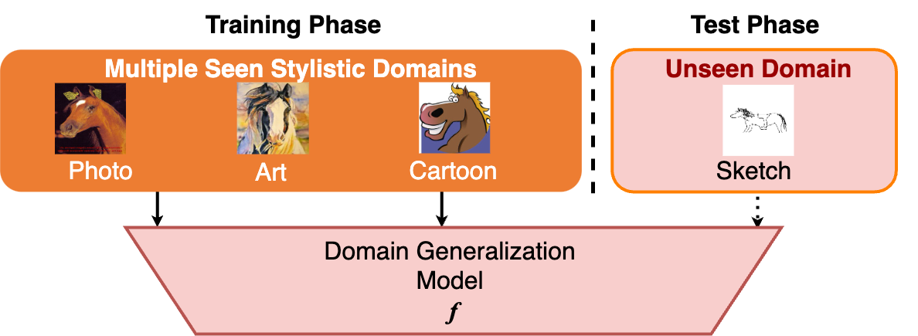
Domain Generalization (DG), as in PACS¹
How well can an image classification model
which is only trained with horses rendered in styles (domains) such as
realistic photos, art paintings, and cartoons
… still recognize horses in the never-seen style of hand sketches?
1. Deeper, broader and artier domain generalization. Li, et al. ICCV 2017.

Slide 3
Domain Generalization (DG) - The Underlying Task
The formalized task of Multi-Source Domain Generalization on stylistic image classification.
Test domain is NOT accessed during training.
See how well a DG model f can generalize onto unseen data distributions.
Minimize the test error on test domain.
1. Deeper, broader and artier domain generalization. Li, et al. ICCV 2017.

Slide 4
Existing Methodology in DG
2. Deep residual learning for image recognition. He, et al. CVPR 2016. 3. ImageNet: A large-scale Hierarchical Image Database. Deng, et al. CVPR 2009.
4. Reducing domain gap by reducing style bias. Nam, et al. CVPR 2021.

Slide 5
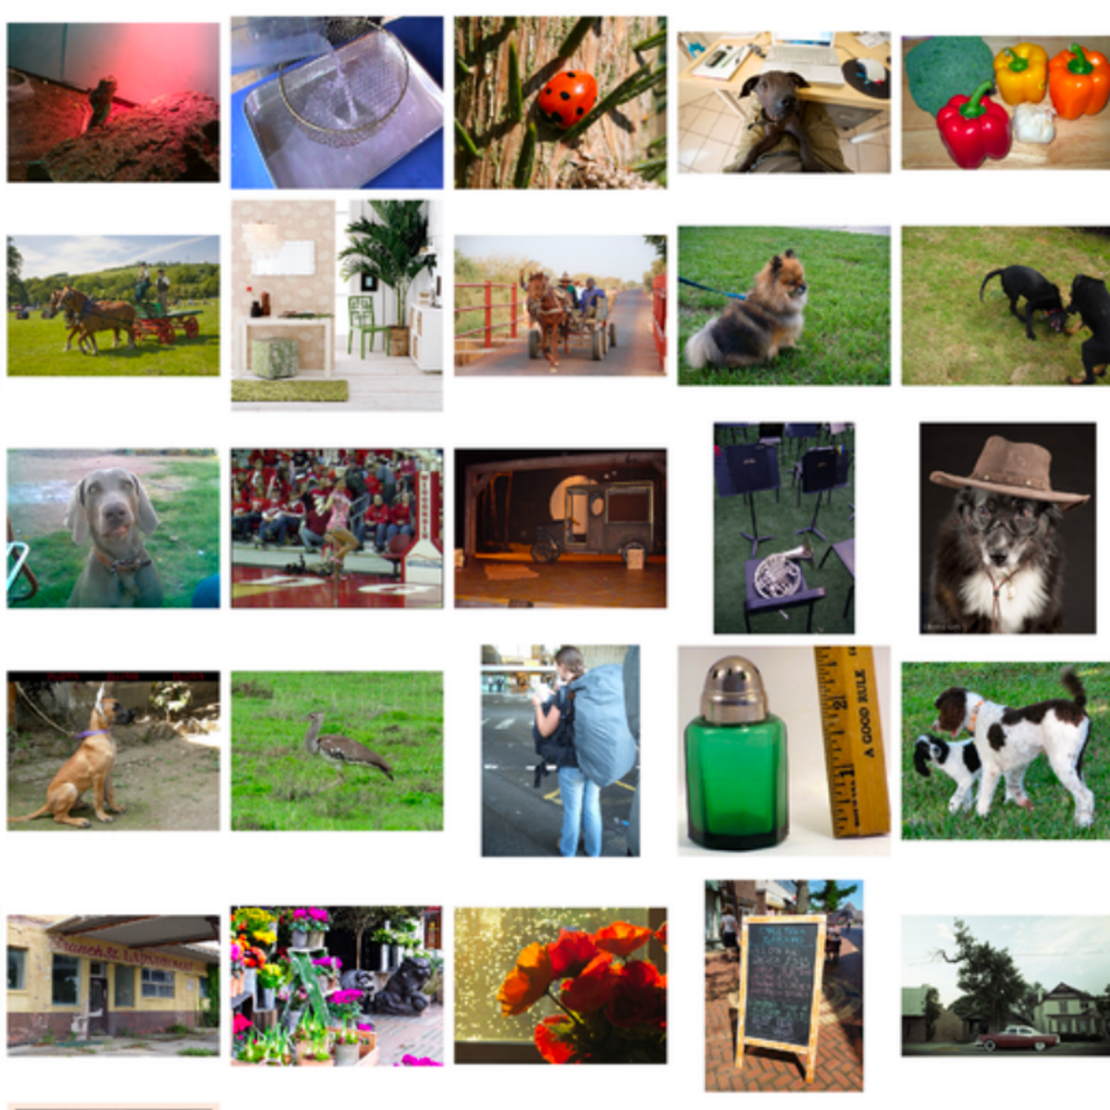
Existing Methodology in DG
Using feature extracting backbones with pre-trained weights from vast image collections, e.g., ResNet-50² pre-trained with ImageNet1K³.
Samples from ImageNet1K³
2. Deep residual learning for image recognition. He, et al. CVPR 2016. 3. ImageNet: A large-scale Hierarchical Image Database. Deng, et al. CVPR 2009.
4. Reducing domain gap by reducing style bias. Nam, et al. CVPR 2021.

Slide 6
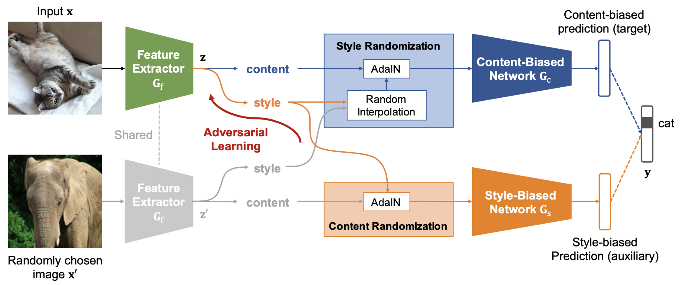
Existing Methodology in DG
Using feature extracting backbones with pre-trained weights from vast image collections, e.g., ResNet-50² pre-trained with ImageNet1K³.
Reducing distances among stylistic domains, and extracting domain-invariant features, e.g. SagNet⁴, etc.
Samples from ImageNet1K³
Pipeline of SagNet⁴
2. Deep residual learning for image recognition. He, et al. CVPR 2016. 3. ImageNet: A large-scale Hierarchical Image Database. Deng, et al. CVPR 2009.
4. Reducing domain gap by reducing style bias. Nam, et al. CVPR 2021.

Slide 7
Existing Methodology in DG - Risks for Inflated Performance
Pre-trained weights are pre-biased, e.g. ImageNet1K is dominated by photo-realistic images⁵.
Domain distances are commonly minimalized in a qualitative way, without quantitative understanding of specific domain differences⁶.
Samples from ImageNet1K³
Pipeline of SagNet⁴
5. Simple: Specialized Model-sample Matching for Domain Generalization. Li, et al. ICLR 2022. 6. Domain Generalization by Mutual-information Regularization with Pre-trained Models. Cha, et al. ECCV 2022.

Slide 8
Our Work - A 3-part Paradigm
Grounding Stylistic Domain Generalization with Quantitative Domain Shift Measures and Synthetic Scene Images
The Measures - Two quantitative measures ICV and IDD that evaluate the shifts of domains in multiple popular DG benchmarks.
The Dataset - SuperMarioDomains (SMD), a multi-domain image collection of unique styles out of scenes in video game graphics.
The DG Method - SMOS, which uses SMD to obtain a precursor model that grounds the training of DG. Achieves top performances on multiple DG benchmarks.

Slide 9
Part 1. The Quantitative Measures of Domain Shifts

Slide 10
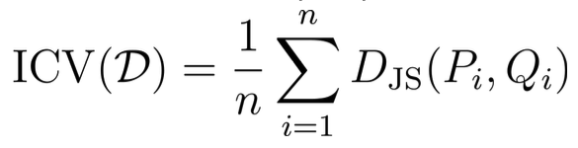
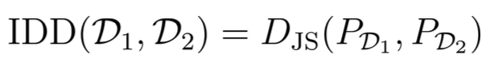
IDD and ICV for DG Benchmark Datasets
Inter-Domain Dissimilarity between two domains
Intra-Class Variation regarding a single domain
- Jensen-Shannon Divergence
Notes:
Inspired by the inter- and intra- variances in stats.

Slide 11
IDD and ICV for DG Benchmark Datasets
Inter-Domain Dissimilarity between two domains
Intra-Class Variation regarding a single domain
- Jensen-Shannon Divergence
- Feature distribution of images
in domain D1
- Feature distribution of images
in domain D2, or pre-training data i.e. ImageNet1K
Notes:
Inspired by the inter- and intra- variances in stats.

Slide 12
IDD and ICV for DG Benchmark Datasets
Inter-Domain Dissimilarity between two domains
Intra-Class Variation regarding a single domain
- Jensen-Shannon Divergence
- Feature distribution of images
in domain D1
- # of classes of domain D
- Feature distribution of images
in domain D2, or pre-training data i.e. ImageNet1K
- Feature distributions of two
randomly split* equal halves of
the images belonging to the
same class i.
*We report all ICVs over the avg. of 3 random trials.
Notes:
Inspired by the inter- and intra- variances in stats.

Slide 13
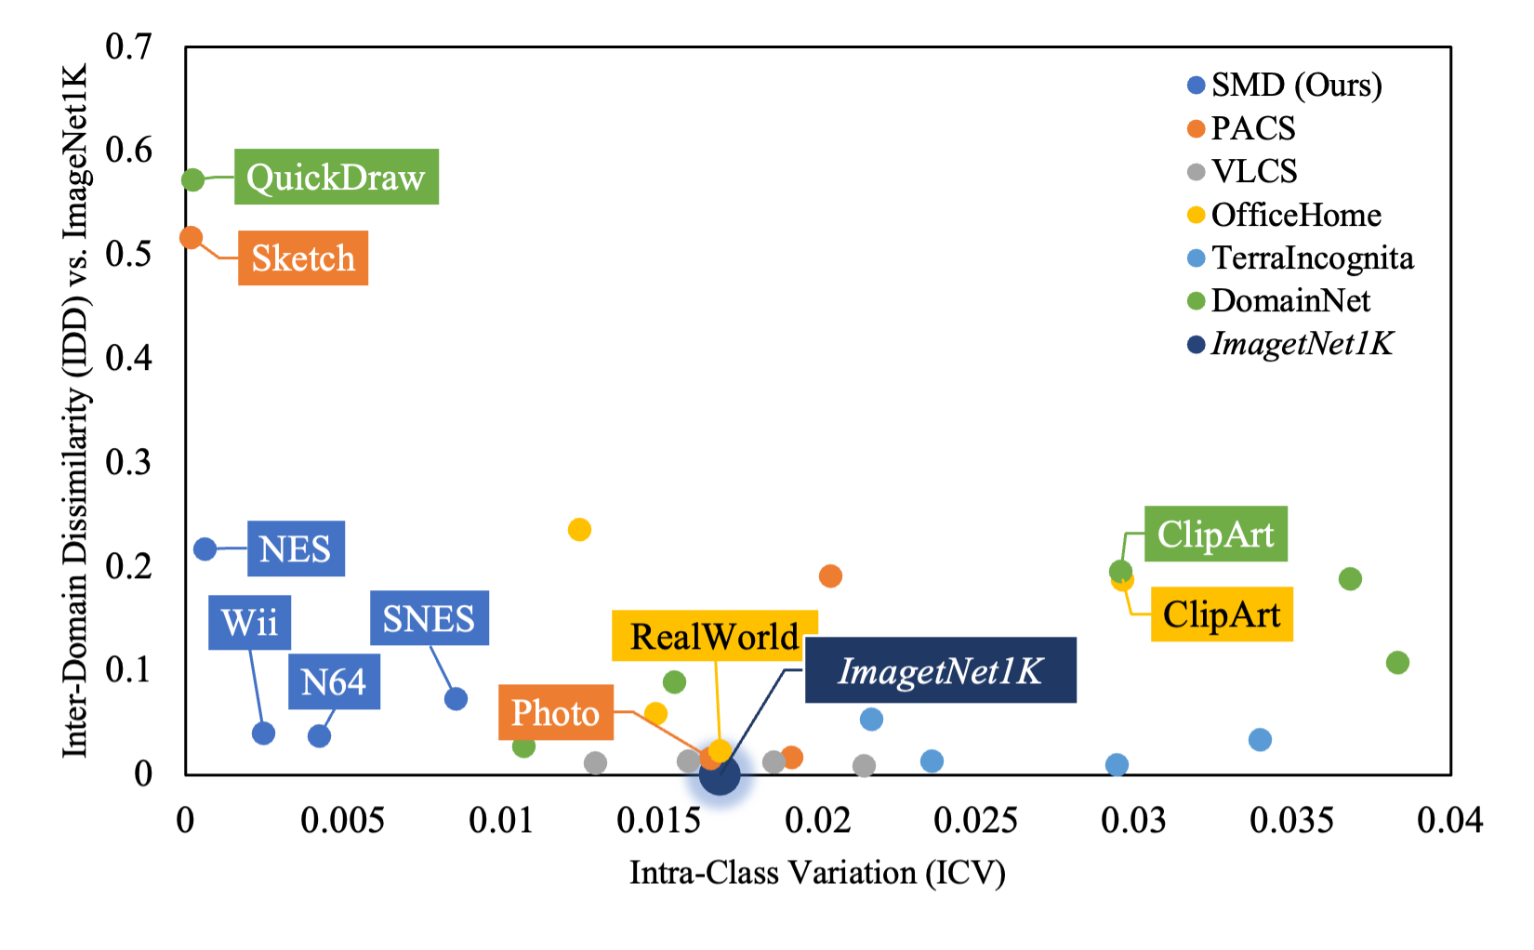
IDD-ICV Scale of DG Benchmarks' Domains*
Domains of similar styles appear close
IDD of ImageNet1K against itself is 0.
The outcasting test domains, e.g. Sketch of PACS, are more abstract in style and are shown to be challenging.
* We study the 5 benchmarks used in DomainBed⁷. 7. In Search of Lost Domain Generalization. Gulrajani and Lopez-Paz. arXiv:2007.01434 2020.
Notes:
In the Original Feature Space (RGB)

Slide 14
Part 2. The Synthetic Scene Dataset

Slide 15
A Biased Edge in Style
Notes:
Spurious Correlation High Risk!

Slide 16
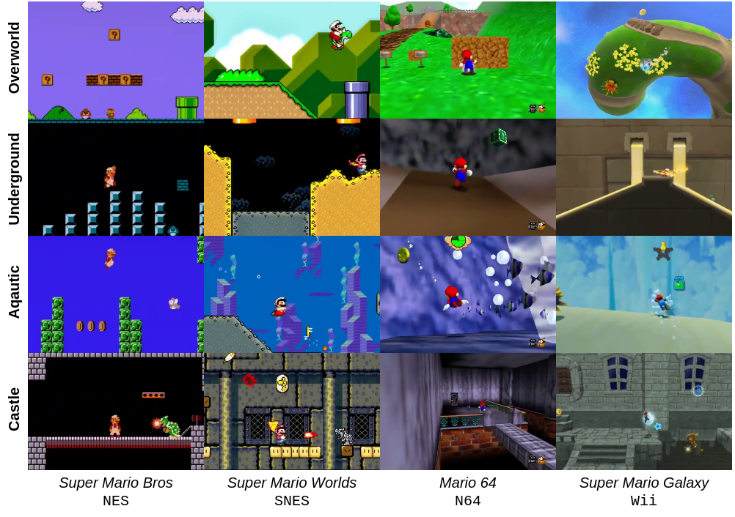
SuperMarioDomains (SMD)
Notes:
All artifacts (like HUDs) are removed

Slide 17
SuperMarioDomains (SMD)
82K image examples
Rows: 4 distinct classes of in-game scenes
Columns: 4 domains of video game graphic styles
Selected over frames of actual gameplay footages from user-generated Let's Play videos
Notes:
All artifacts (like HUDs) are removed

Slide 18
SuperMarioDomains over the IDD-ICV Scale

Slide 19
SuperMarioDomains over the IDD-ICV Scale
Domains of SMD are designed to counterbalance the stylistic bias introduced by ImageNet1K.
Low in ICV and high in IDD

Slide 20
Part 3. The DG Method Grounded by a Precursor

Slide 21
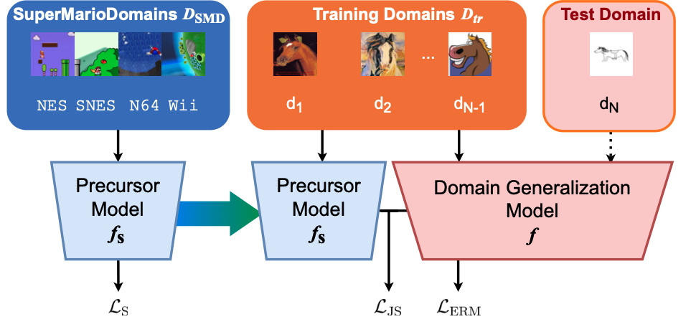
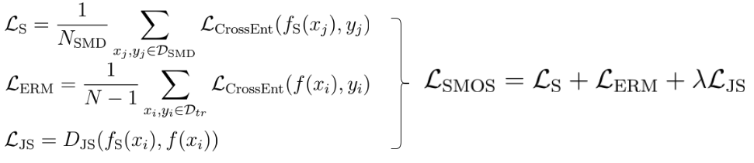
The SMOS Pipeline - Grounding DG with SMD-trained Precursor
Scene-grounded Minimal dOmain Shift
Training loss of SMOS:
(𝛌 is a hyperparameter)
SMOS⁻ - Precursor fs is ResNet50 initialized from scratch.
SMOS⁺ - Precursor fs is ResNet50 initialized with pre-trained weights from ImageNet1K.

Slide 22
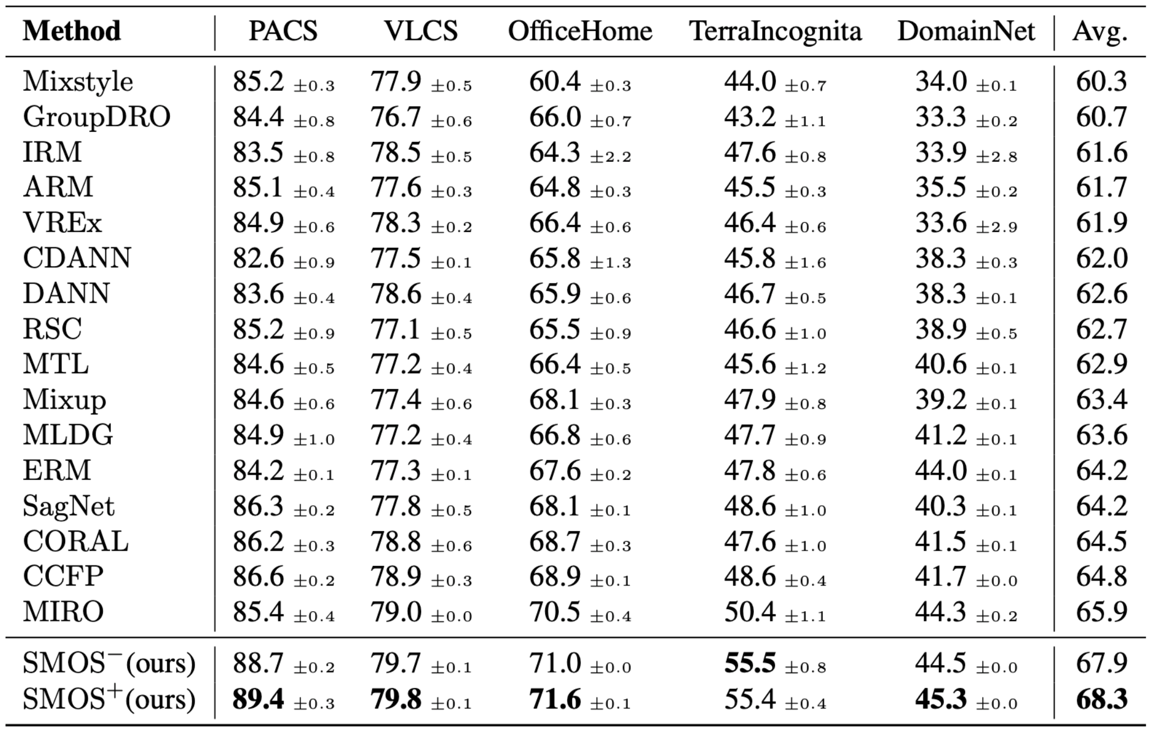
Performances on Benchmarks - The Averages of Leave-One-Out
All using ResNet50 as the DG feature extraction backbone f. Avg. of 3 trials.

Slide 23
Performances on Benchmarks - Individual Abstract Test Domains
Abstract-styled domains of multi-style benchmarks, such as Sketch of PACS¹ or Quickdraw of DomainNet⁸, are difficult to generalize to.

Slide 24
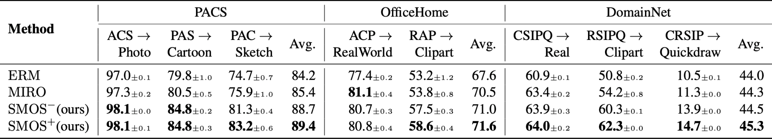
Performances on Benchmarks - Individual Abstract Test Domains
Abstract-styled domains of multi-style benchmarks, such as Sketch of PACS¹ or Quickdraw of DomainNet⁸, are difficult to generalize to.
SMOS is able to achieve particularly large improvements on such abstract-styled test domains while maintaining on-par performances with SOTAs on others.
<Training domains> → <Test domain>

Slide 25
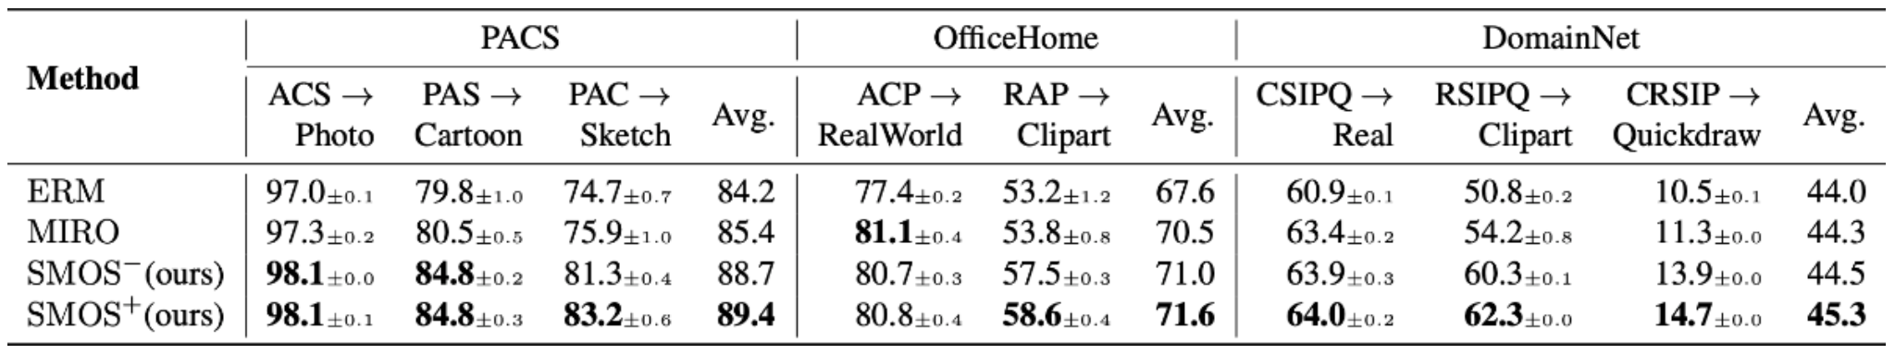
SMOS' Improved Generalizability Measured with IDD

Slide 26
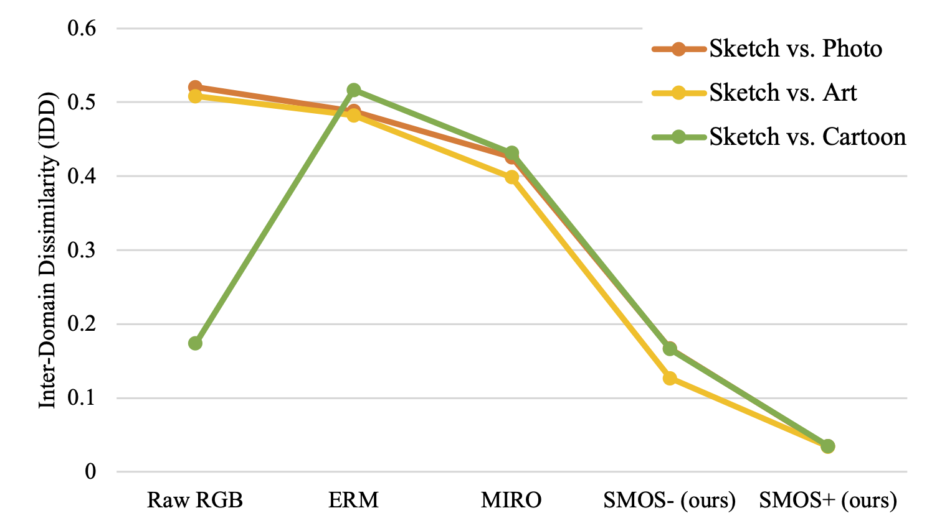
SMOS' Improved Generalizability Measured with IDD
SMOS (with SMD) is shown to project extracted features of seen and unseen domains into closer proximity in terms of IDD.
Test domain (Sketch) vs. Every other training domain in PACS

Slide 27
Ablation - Replacing SMD with Substitute Precursor Data in SMOS
The Precursor substitutes to SMD:
Notes:
We find that SMOS retains the best DG performance when it utilizes SMD’s unique stylistic domain shifts and scene labels. In contrast, we see that training the precursor model with ImageNet1K-like image styles (Places365) or less consistent stylistic domains (DomainNet) leads to lower improvements, if not worse performance, than the baseline methods.

Slide 28
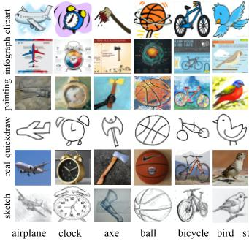
Ablation - Replacing SMD with Substitute Precursor Data in SMOS
The Precursor substitutes to SMD:
DomainNet⁸ of 300+ object classes and 6 stylistic domains.
8. Moment Matching for Multi-source Domain Adaptation. Peng, et al. ICCV 2019.
DomainNet
Notes:
We find that SMOS retains the best DG performance when it utilizes SMD’s unique stylistic domain shifts and scene labels. In contrast, we see that training the precursor model with ImageNet1K-like image styles (Places365) or less consistent stylistic domains (DomainNet) leads to lower improvements, if not worse performance, than the baseline methods.

Slide 29
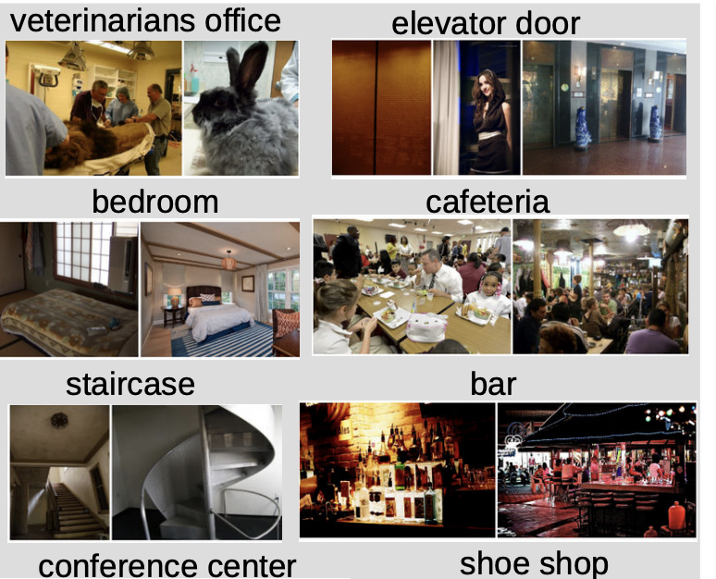
Ablation - Replacing SMD with Substitute Precursor Data in SMOS
The Precursor substitutes to SMD:
DomainNet⁸ of 300+ object classes and 6 stylistic domains.
Places365⁹ of 365 scene classes in one photo-realistic style.
8. Moment Matching for Multi-source Domain Adaptation. Peng, et al. ICCV 2019.
9. Places: A 10 million Image Database for Scene Recognition. Zhou, et al. PAMI 2017.
DomainNet
Places365
Notes:
We find that SMOS retains the best DG performance when it utilizes SMD’s unique stylistic domain shifts and scene labels. In contrast, we see that training the precursor model with ImageNet1K-like image styles (Places365) or less consistent stylistic domains (DomainNet) leads to lower improvements, if not worse performance, than the baseline methods.

Slide 30
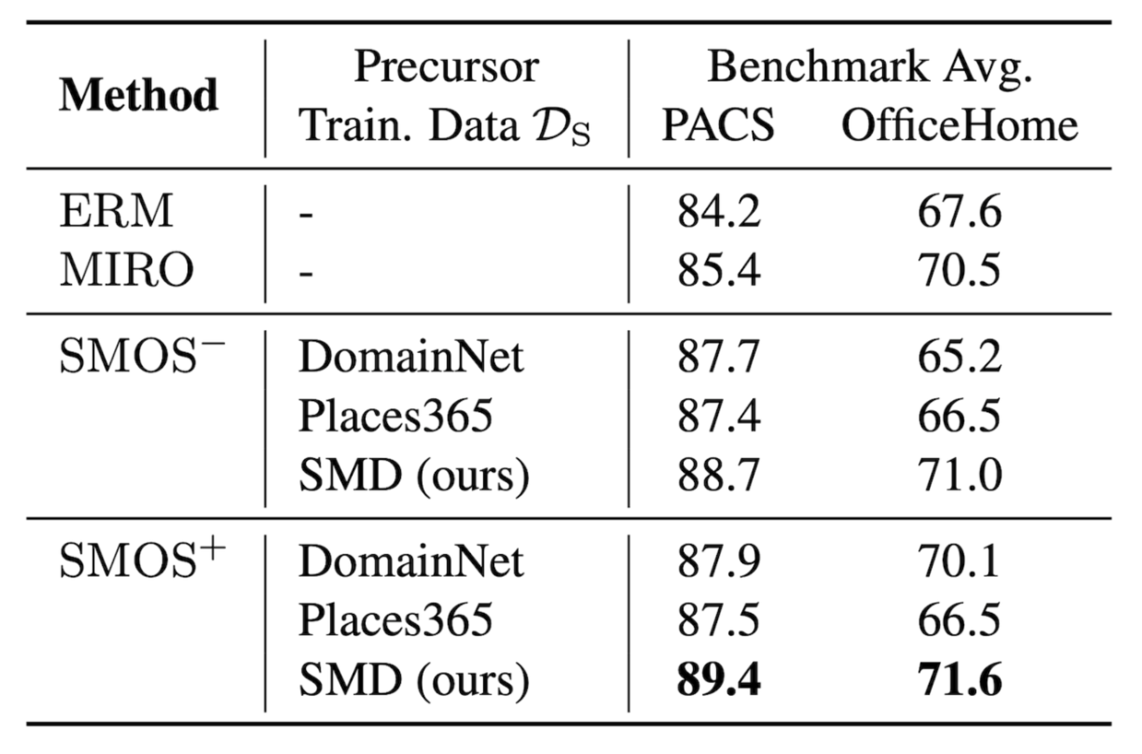
Ablation - Replacing SMD with Substitute Precursor Data in SMOS
The Precursor substitutes to SMD:
DomainNet⁸ of more variant object classes and stylistic domains than SMD.
Places365⁹ of 365 scene classes in one photo-realistic style.
Substitute precursor data all downsampled to the same size of SMD (82k). Average of 3 trials.
8. Moment Matching for Multi-source Domain Adaptation. Peng, et al. ICCV 2019.
9. Places: A 10 million Image Database for Scene Recognition. Zhou, et al. PAMI 2017.
DomainNet
Places365
Notes:
We find that SMOS retains the best DG performance when it utilizes SMD’s unique stylistic domain shifts and scene labels. In contrast, we see that training the precursor model with ImageNet1K-like image styles (Places365) or less consistent stylistic domains (DomainNet) leads to lower improvements, if not worse performance, than the baseline methods.

Slide 31
Our Work - A 3-part Paradigm
Grounding Stylistic Domain Generalization with Quantitative Domain Shift Measures and Synthetic Scene Images
The Measures - Two quantitative measures ICV and IDD that evaluate the shifts of domains in multiple popular DG benchmarks.
The Dataset - SuperMarioDomains (SMD), a multi-domain image collection of unique styles out of scenes in video game graphics.
The DG Method - SMOS, which uses SMD to obtain a precursor model that grounds the training of DG. Achieves top performances on multiple DG benchmarks.

Slide 32


Thank you!
arxiv.org/abs/2405.15961
github.com/fpsluozi/SMD-SMOS
Yiran Luo^{ASU}, Joshua Feinglass^{ASU}, Tejas Gokhale^{UMBC}, Kuan-Cheng Lee^{ASU}, Chitta Baral^{ASU}, Yezhou Yang^{ASU}
yluo97@asu.edu
The 3rd VDU Workshop @ CVPR 2024

Slide 33
Acknowledgements
The authors acknowledge Research Computing at Arizona State University for providing HPC resources and support for this work. This work was supported by NSF RI grants #1750082 and #2132724.
The release of the SMD dataset will abide Nintendo Game Content Guidelines for Online Video & Image Sharing Platforms (Updated 10/24/2023) https://www.nintendo.co.jp/networkservice_guideline/en/index.html under the Open Database License (ODbL).
Additional gratitude to Michael Saxon of UCSB and Agneet Chatterjee of ASU for their support.

